Slide 1

SMART EXPENSE TRACKER
A MINI C++ PROJECT
TEAM MEMBERS
VASAMSETTI JAHNAVI DEVI
DEVISETTI VENKATA RISHI RAJ
TELU MALLIKARJUN
GUMMALLA VEERA MANIKANTA VIVEK

Slide 2

ITRODUCTION
Expense management is important in daily life
Manual tracking is difficult and error-prone
This project provides a simple digital solution
Built using C++ and basic programming concepts

Slide 3
OBJECTIVES
To develop a system to manage expenses
To allow users to:
Add expenses
View records
Search data
Delete entries
To implement using C++ and data structures

Slide 4
FEATURES
🔐 Login system
➕ Add expense
📄 View expenses
🔍 Search by date
📅 Monthly report
💰 Total expense
🗑️ Delete expense

Slide 5
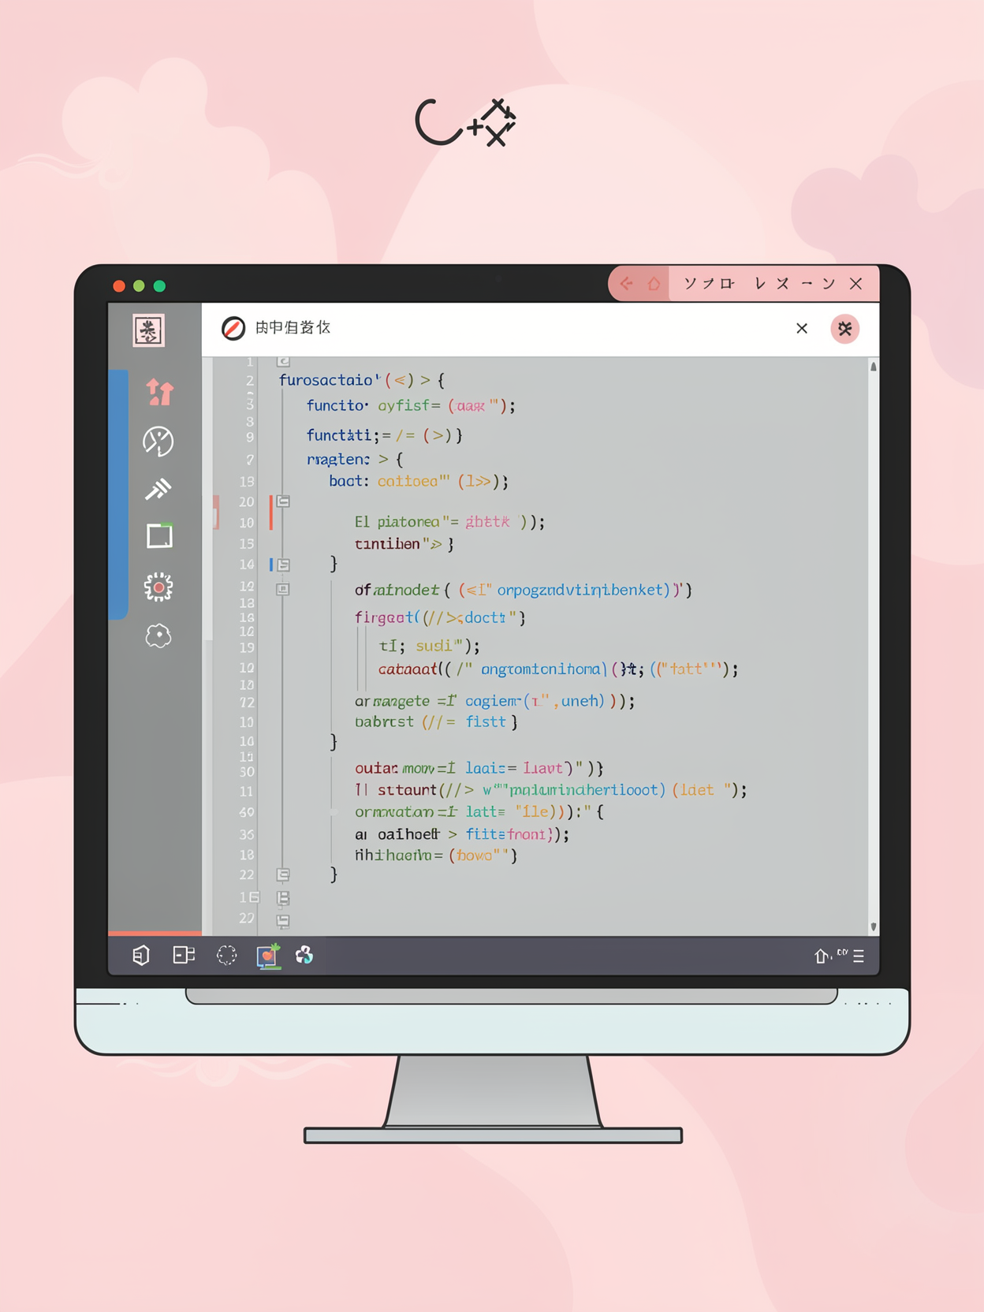
TECH NOLOGIES USED
Programming Language: C++
Concepts Used:
Structures
Vectors
Loops
Functions
Exception Handling

Slide 6
METHODOLOGY
Menu-driven program
Data stored using vector (dynamic array)
User input handled using
getline()
Operations performed:
Insert
Delete
Search
Display

Slide 7
SYSTEM WORKFLOW
Start program
Create & verify password
Display menu
User selects operation
Perform action
Repeat until exit

Slide 8
ALGORITHM
Start
Login authentication
Display menu
Take user input
Perform selected operation
Repeat until exit
End

Slide 9
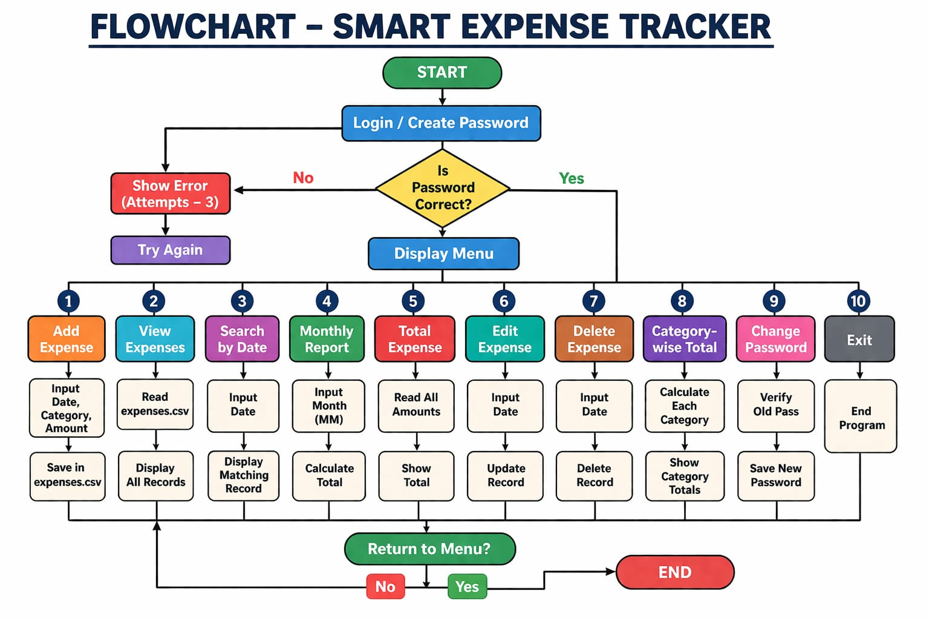
FLOWCHART

Slide 10
ADVANTAGES
Simple and easy to use
Fast execution
No external dependencies
Error handling included
Efficient data management

Slide 11
Future enhancements
File storage (save data permanently)
GUI interface
Edit expense feature
Charts and analytics
Mobile/web version

Slide 12
limitations
Data is not stored permanently
No graphical interface
Works only in console

Slide 13
CONCLUSION
Successfully implemented expense tracker
Demonstrated use of C++ concepts
Efficient for small-scale usage Can be expanded into real-world application

Slide 14


